Slide 1
JS
NODE
Introduction - Packages

Slide 2
WHAT IS THE BACK ?

Slide 3



What we have learnt last week ?
How JS can wait
For the requested data
Request (GET) to a web service
using HTTP
(FRONT)
(FRONT)
PROMISE
CALLBACK
RESPONSE
REQUEST
ASYNCRHONOUS

Slide 4



What we are learning this week ?
Run a back with node
Install and request modules
Read/Write files
REQUIRE
(BACK)
INSTALL
Notes:
Interpreter : reads the Javascript. Difference : this one isnt a browser, it is not made to display anything, but run a server !
Packages : Pre-made batch of codes to serve complexe functions allowing awesome functionalities.

Slide 5
What we will learn next week ?
Commutate between your FRONT and your BACK
(FRONT)
RESPONSE
REQUEST
(BACK)
Notes:
Interpreter : reads the Javascript. Difference : this one isnt a browser, it is not made to display anything, but run a server !
Packages : Pre-made batch of codes to serve complexe functions allowing awesome functionalities.

Slide 6

OBJECTIVES FOR TODAY
What is NODE ?
What is a MODULE ?
EXPORT and REQUIRE
What is a BUILD-IN MODULE ?

Slide 7

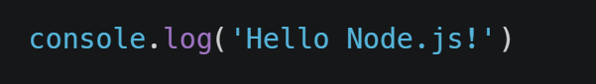
EXPLORE
ACTIVITY 1
10 MIN
My first node project !
0 – Check node is installed : “node –v”
1 – Create a new javascript file, index.js
2 – Write the following line :
3 – Open the terminal and type : “node index.js”
What do you see ?
What can you conclude about Node ?
Notes:
Do it yourself after 5 min while presenting. Then explain again node allows execution of javascript server side (on your computer, without browser).

Slide 8
node <YOU FILE JS>
Run your JS using Node

Slide 9
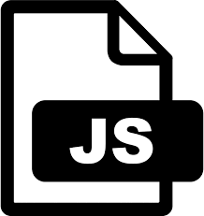

On the FRONT
JS files are executed on browser
ON the BACK
JS files are executed on Node
(FRONT)
(BACK)
Notes:
Javascript is interpreted by the browser in the front
But the browser is the client side, we need to do things server side (send requests, to give a response for example) how do we execute the code on the server side ?
We cannot use the browser : it’s an interface. => we use nodejs
Interpreter : reads the Javascript. Difference : this one isnt a browser, it is not made to display anything, but run a server !

Slide 10


MODULES are functions to add to your code
JS
JS + MODULES
http
URL parser
File system
Notes:
Modules let you do things you couldnt do before, very fast

Slide 11

You cannot “see” functions / variables of another file
operations.js
function addNumber(a, b) {
return a +b;
}
test.js
console.log( addNumber(4, 5));
What is the result on the console ?
Notes:
myAdd is not defined : test,js does not know the functions defined in operations,js

Slide 12
Let put a value in the module export
operations.js
module.exports.dayInWeek = 7
test.js
const myModule = require("./operations.js");
console.log(myModule);
console.log(myModule.dayInWeek);
What do you see on the first line ?
On the second line ?
Notes:
key "dayInweek" has been created with the value 7

Slide 13
Let put a function in the module export
operations.js
function addNumber(a, b) {
return a +b;
}
module.exports.myAdd = addNumber;
test.js
const myModule = require("./operations.js");
console.log(myModule);
console.log(myModule.myAdd(2, 3);
What do you see on the first line ?
On the second line ?
Notes:
key "dayInweek" has been created with the value 7

Slide 14
To use a module data or function: export it, require it
library.js
main.js
let lib = require("./library.js");
let a= 2
let b= 2
lib.a
AVAILABLE
let c= 2
lib.b
AVAILABLE
module.exports.a =a;
lib.c
NOT AVAILABLE
module.exports.b =b;

Slide 15
EXPLORE
ACTIVITY 2
15 MIN
Create a module and use it in a main file
library.js
write a function min(a, b) to compute the min of 2 numbers
write a function max(a, b) to compute the max of 2 numbers
create a constant PI = 3.14
create a constant COVID = 19
export : min, COVID (but not other ones)
main.js
require library.js
check you can use min, COVID
check you cannot use max, PI

Slide 16

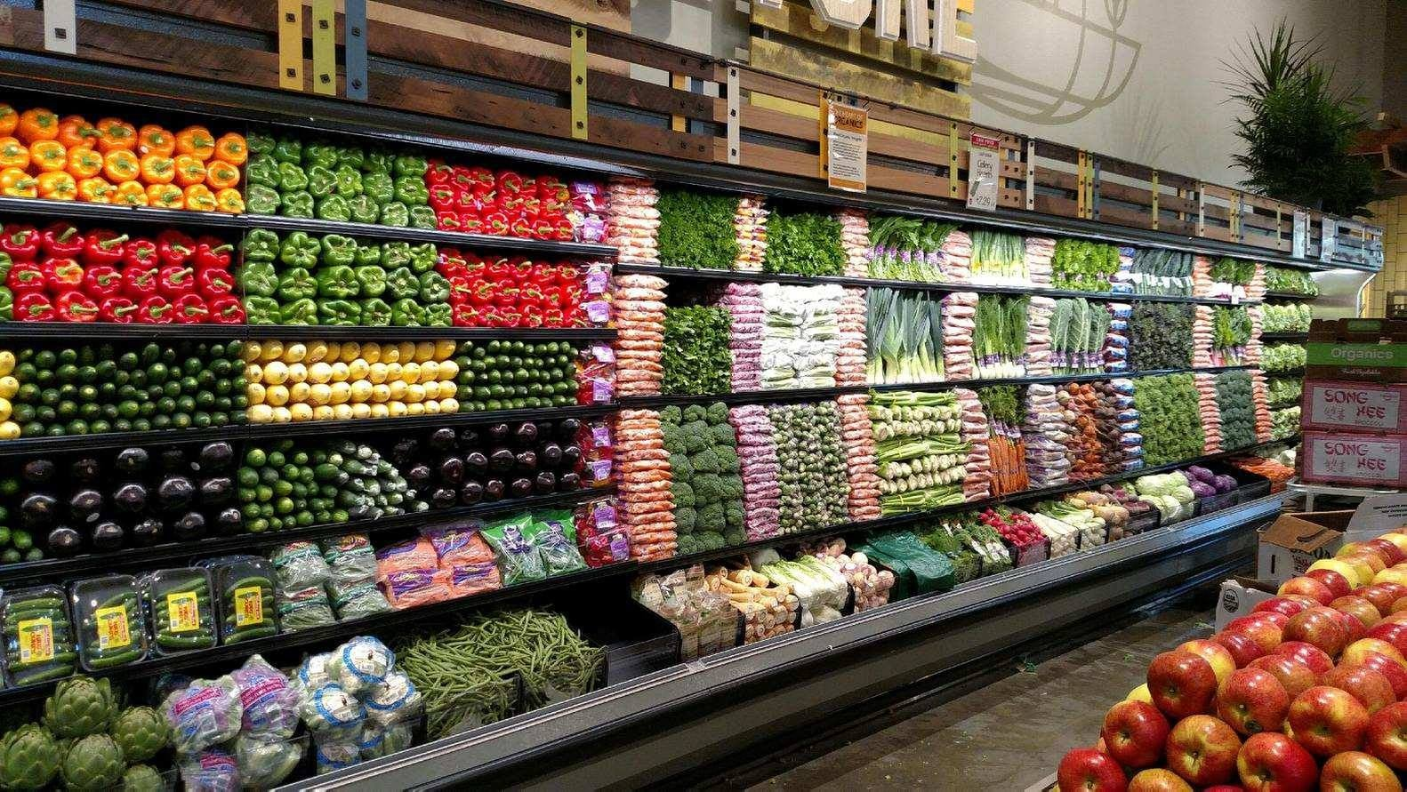
NO MODULES
MODULES
ALL IN THE SAME PLACE
SEPARATE THE JOBS
Notes:
« Separation of concern »

Slide 17
Benefits of modules
Less code lines in one file
Each file has its own job
Easier to understand
Notes:
« Separation of concern »

Slide 18

What are build-in modules ?
Node.js has a set of built-in modules which you can use without any further installation.
Notes:
External modules are not in nodejs natively, you need to get them from the internet.
=> Nodejs has a

Slide 19

build-in
Read a file with FS
let fs = require("fs");
let content =
fs.readFileSync(“bob.txt").toString();
console.log(first);
bob.txt
Toto
Tata
Tutu

Slide 20
build-in
Write a file with FS
bob.txt
let fs = require("fs");
let text = ‘BIBI\nBOBO’;
fs.writeFileSync(“bob.txt”, text)
BIBI
BOBO

Slide 21
EXPLORE
ACTIVITY 3
Read/Write a file with FS
See instructions
Notes:
Lecture écriture d’un fichier en exploitant un built in module

Slide 22
NOW YOU KNOW
LINKS
What is NODE ?
Nodejs documentation : https://nodejs.org/api/modules.html
NodeJS documentation module oriented :
https://nodejs.org/dist/latest-v11.x/docs/api/fs.html
Nodejs File System guide :
https://www.tutorialsteacher.com/nodejs/nodejs-file-system
What is a MODULE ?
EXPORT and REQUIRE
What is a BUILD-IN MODULE ?
Notes:
Link with Python : equivalent

